Slide 1
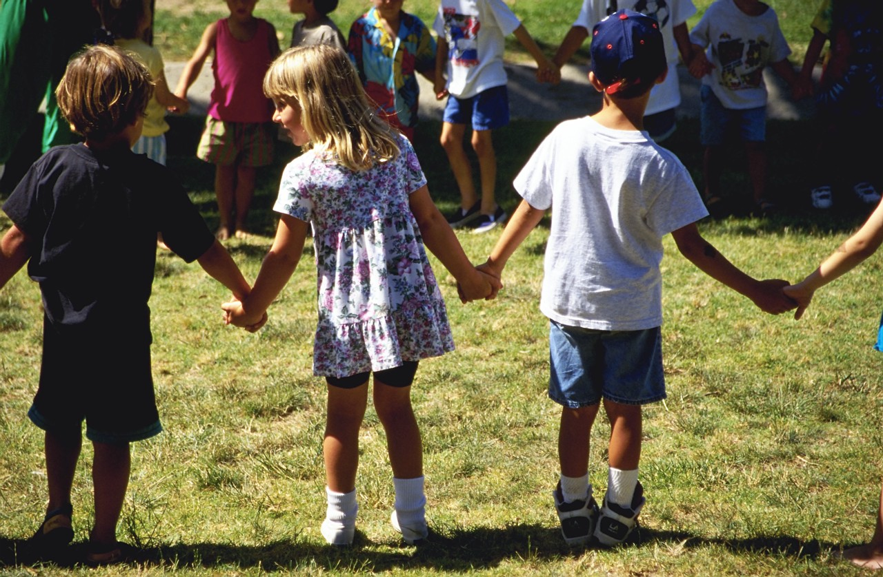
Building and Sustaining
Early Childhood
Community Councils
Together we are better http://www.collaboratingpartners.com/index.php

Slide 2
Welcome and Overview
WHY are we here together?
WHAT will we accomplish today?
HOW will we accomplish our work?
Next steps to support our work
Notes:
Building community capacity is the combined influence of a community’s commitment, resources and skills that can be deployed to build on community strengths and address community needs. Collaboration is the structure or a group working together to achieve a shared vision. Effective organizations learn continuously and use their knowledge to increase effectiveness.

Slide 3
Four Main Focus Areas
Building the Council
Clarifying purposes
Shared leadership
Sustaining
Notes:
There are four main focus areas when considering a council:
Building the council
Clarifying purpose
Leadership
Sustaining the council

Slide 4
Building Your Collaboration Council
Notes:
When building your council, consider who is in your community? Who are the folks that need to be at the table?

Slide 5

Reflective Questions
Why do we want a council in our community?
How do I take this information and apply it to my own community?
Notes:
It is important to reflect on these important questions with the folks you have at the table.

Slide 6
Clarifying Your Purpose
Core Values
Mission
Vision
Notes:
CLARIFYING PURPOSE:
Clarifying purpose create a crystal-clear strategy for achieving team goals as they relate to the organization’s mission and success. It:
*creates the ability to connect the purpose of the mission, values, and strategy of the group.
*provides the means to help team members understand their jobs an how they are key contributors to the organization’s goals.
•provides skills, tools, and a plan for leading the team in executing on the organization’s most important goals.
•helps to establish a clear Team Purpose Statement to implement with the team. (Covey)
Understanding your purpose is critical to achieving organizational success. It provides the compelling reason that staff and volunteers come together and work. It propels the team toward a more desirable future state.
Questions that can help you clarify your organization’s purpose include:
1.Why do we exist?
2.What are we passionate about?
3.What change do we want to create?
4.What would be different if we were really successful in our work?
5.What do the people we serve need from us? What are the issues they are trying to resolve? How does our organization meet that need?
Once the purpose and aspiration of the team is clear, you can them move on to figure out what can and will be acted upon to fulfill that
purpose.
(pathwaysfacilitation.com)

Slide 7
Reflective Questions
Why should this council exist in our community?
What unique purpose would the council fill in your community?
What could be a focus for your group?
Notes:
These are important questions for your group to answer to guide you in your work.

Slide 8
Leadership
Planning for shared leadership
Roles and responsibilities
Notes:
LEADERSHIP:
The essentials for community capacity don’t “just happen” they are developed through effort and will, initiative and leadership.
Effort and will, initiative and leadership are needed to:
*Involve/educate community members and galvanize commitment to act
*Attract and collect resources, compile information, and shape ways for deploying these resources to catalyze change in how problems are identified, addressed and opportunities are seized.
*Organize people and work, develop skills, coordinate or manage sustained effort that builds up the positive qualities of community life that enable a community to address challenges and recognize and act on opportunities.

Slide 9
Getting Organized
Key roles and responsibilities
Funding sources
How to address change
Notes:
Why
What
How

Slide 10
The Power of Relationships
Systems Integration Model
Communicate to give and exchange information
Cooperate to assist each other
Coordinate in joint planning/synchronization
Collaborate toward mutual goals and gains
Convergence for restructuring as needed
Consolidation to become united and harmonized

Slide 11
Reflective Question
Who in your community could be potential leader/s?

Slide 12
Sustaining Collaboration Councils
Notes:
Sustaining the Council:
This is always an important topic of discussion regarding any effort.
Research has provided some guidelines for success which include:
Sustaining relationships among partners (e.g., collaborative principles, well-defined partnership structures and processes, nurturing champions in partner organizations, assuring benefits to partners);
Implementing projects with clear short-term benefit to communities;
Having organizational commitment to assure stability of organizational participation;
Engaging leaders of public health, academic organizations, local government and funders;
Basing activities in an institution with the capacity and flexibility to sustain efforts through lean times;
Enhance legitimacy by increasing visibility within funding agencies and public agencies;
Projects are focused and adapt to changing community interests and needs to sustain community interest;
Sustaining the effort requires:
*Leadership and structure
*Process
*Maintaining participation and inclusion
*Resources
*Transference of knowledge and capacity
*Evaluation
*Celebration
(Change Project: Healthy Communities: Sustaining the Effort)

Slide 13

It Takes a Community
Relationships are the glue that holds community together
All members focusing on the best interests of young children and their families create great communities

Slide 14

Strengthen Natural Connections
How can we strengthen the natural connections that are essential for our children to thrive in this community?

Slide 15



The P.D.S.A Cycle
Do
Notes:
PDSA:
Plan: Understand the system and select the team
Define the probletunity
Study the current situation
Analyze the causes
Do: Select and develop a theory for improvement
Implement the theory for improvement
Study: Study the results
Act: Standardize the improvement
Reflect and establish future plans

Slide 16
Reflective Questions
What do you think will be especially important in sustaining your council?
Based on that, what would you want to consider putting in place?

Slide 17
Together We Are Better
Small Changes – Dramatic Results
Welcoming atmosphere
Caring collaborative relationships
Regular and consistent communication
Shared vision, goals and work
Acknowledgement of contributions
Intentionality for sustainability
Notes:
These are some simple but critical components for success!

Slide 18
Resources
The Asset-based Community Development Institute, Tom Mosgaller: http://www.abcdinstitute.org/faculty/mosgaller/
Building Community Capacity: The Potential of Community Foundations, by Steven E. Mayer: http://www.effectivecommunities.com/index.html
Center for Ethical Leadership, Gracious Space: http://www.ethicalleadership.org/gracious-space.html
Margaret Wheatley: http://www.margaretwheatley.com/writing.html
The Berkana Institute: http://berkana.org/
Video: Ounce of Prevention: Change the First Five Years: http://www.ounceofprevention.org/news/downloads.php

